Slide 1



Slide 2
Predicting classroom occupancy
Brett Tully

Slide 3
Proposal - Introduction
Classroom/Confrence room occupancy has become a critical issue in recent times, especially with the COVID-19 pandemic
The proposed project aims to predict classroom occupancy using Raspberry Pis with temperature sensors
Raspberry Pis with temperature sensors will be installed in classrooms.
The sensors will send data (timestamp, temperature, humidity, and classroom number) to a cloud SQL database.
The data will be imported into a Jupyter notebook for analysis.
Machine learning algorithms will be used to predict classroom occupancy based on temperature and humidity data.

Slide 4
Proposal - Goals
To predict classroom occupancy accurately using temperature, humidity data, and weekday
To provide real-time information about classroom occupancy
To help schools and universities make informed decisions about classroom management

Slide 5
Hardware
Raspberry Pi 4 Model B
Temperature/Humidity Sensor (DHT22)
Power Supply
Ethernet Cable

Slide 6
Software
Raspbian OS
Python
MySQL Database
Jupyter Notebook
Tableau

Slide 7
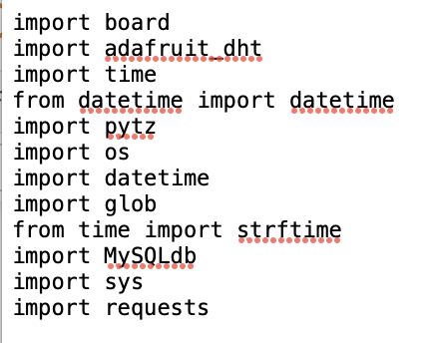
Data Collection System – Raspberry Pi Python Script

Slide 8
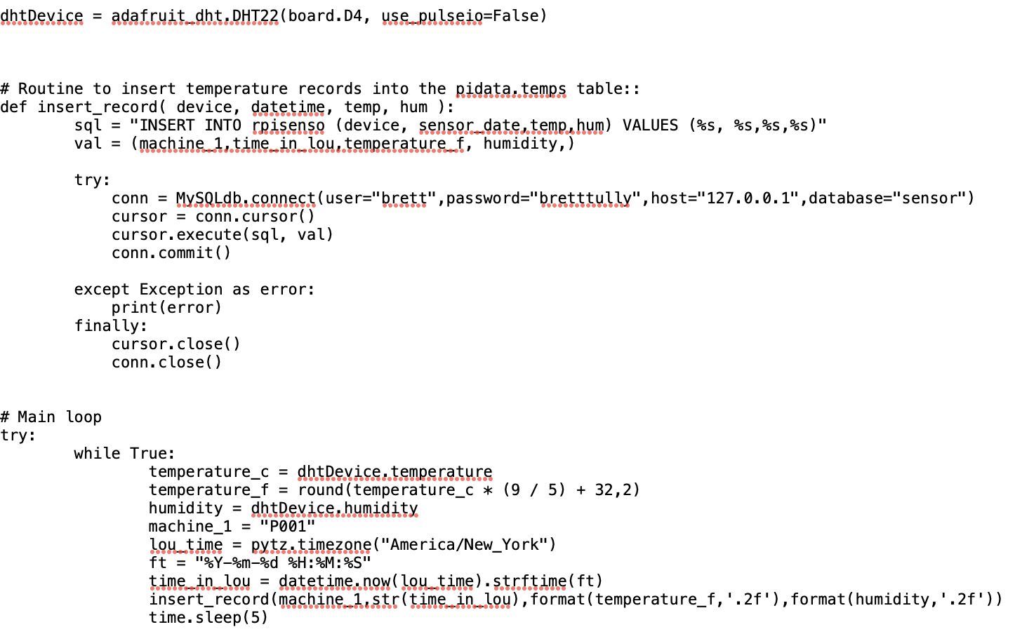
Data Collection System – Raspberry Pi Python Script

Slide 9
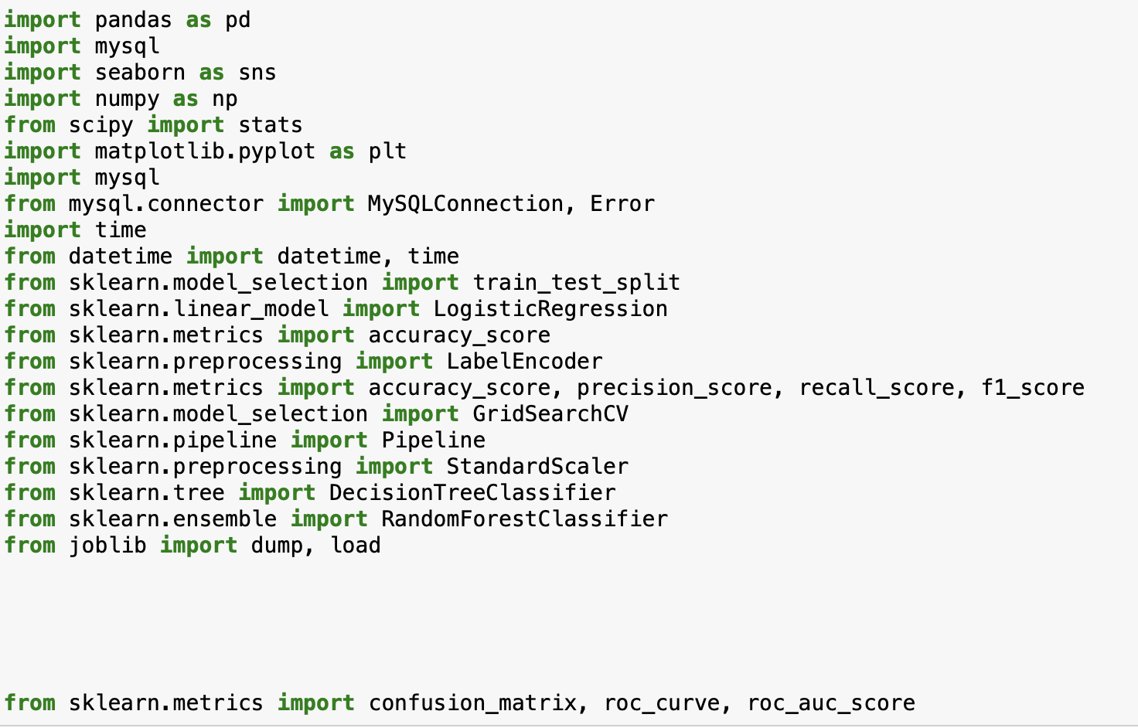
Data Collection System – Jupyter notebook

Slide 10
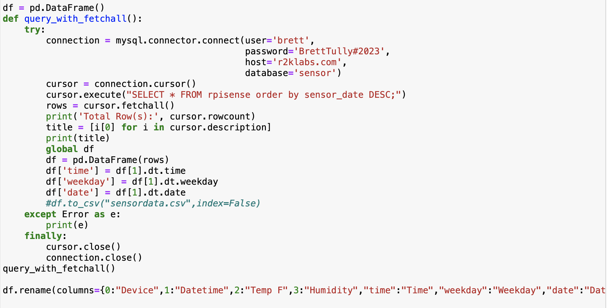
Data Collection System – Jupyter notebook

Slide 11
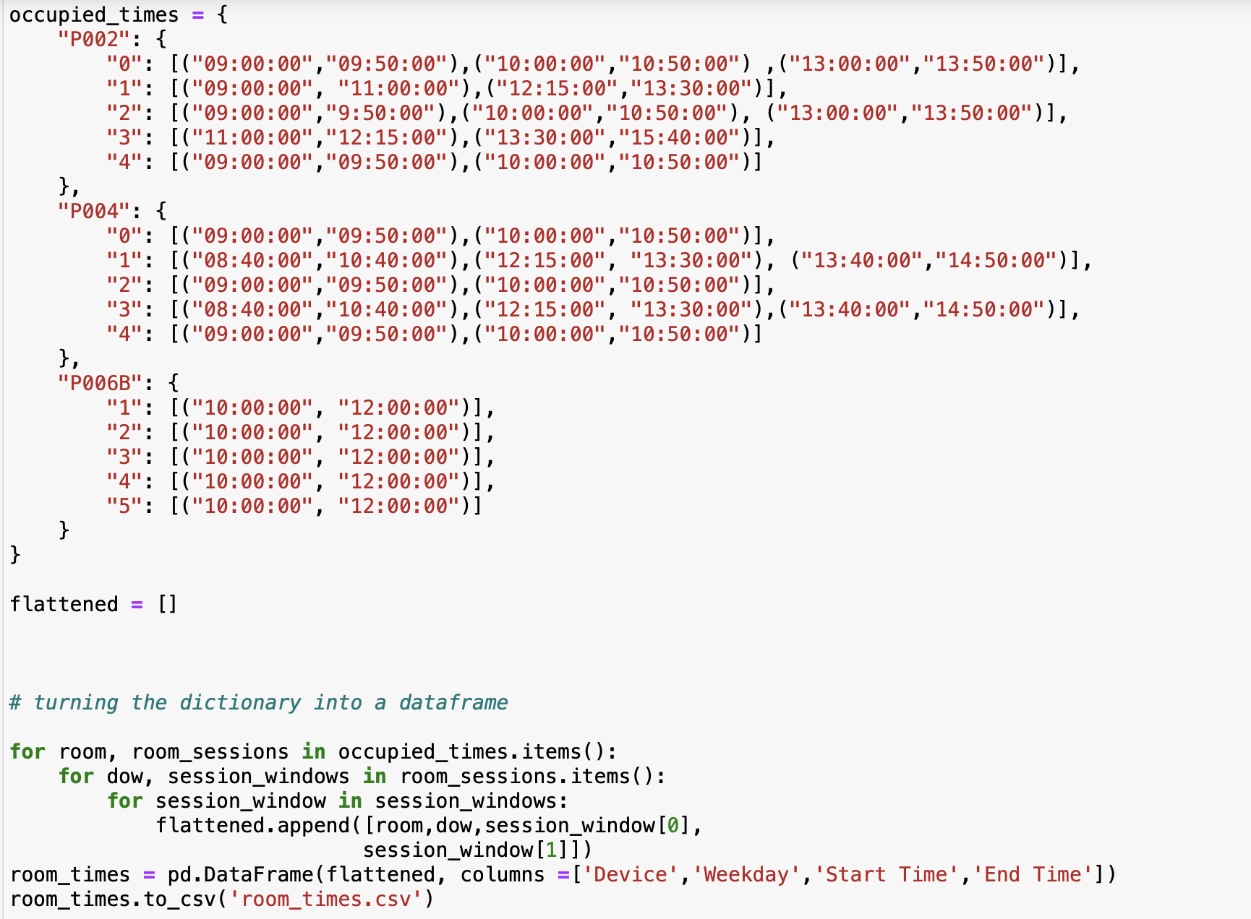
Data Collection System – Jupyter notebook

Slide 12
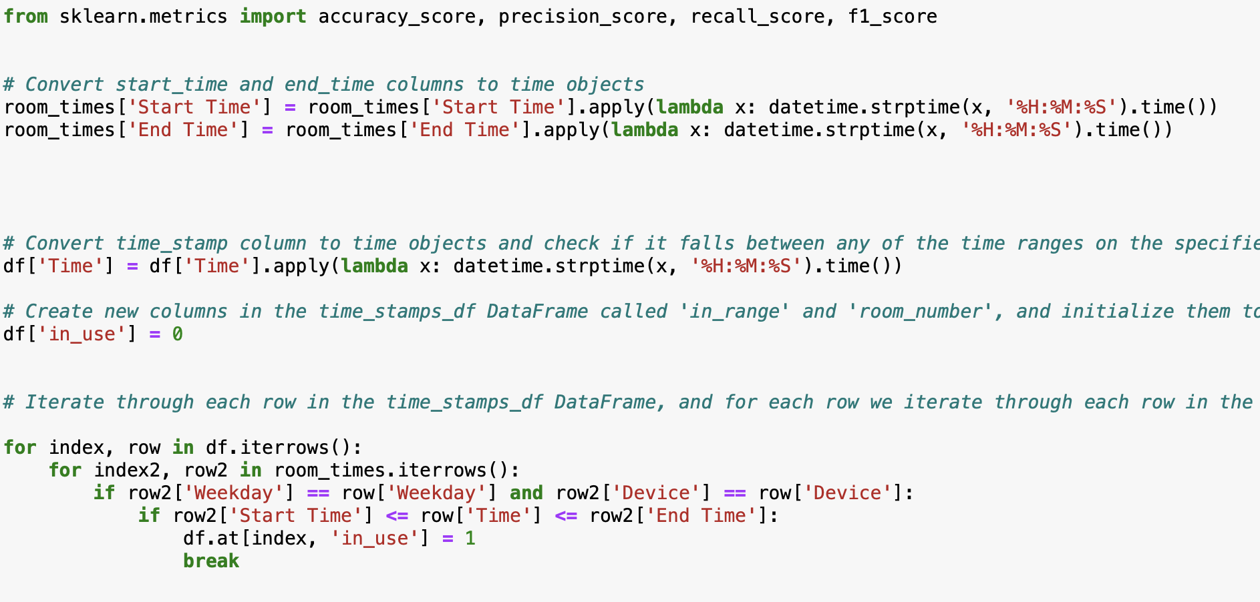
Data Collection System – Jupyter notebook

Slide 13
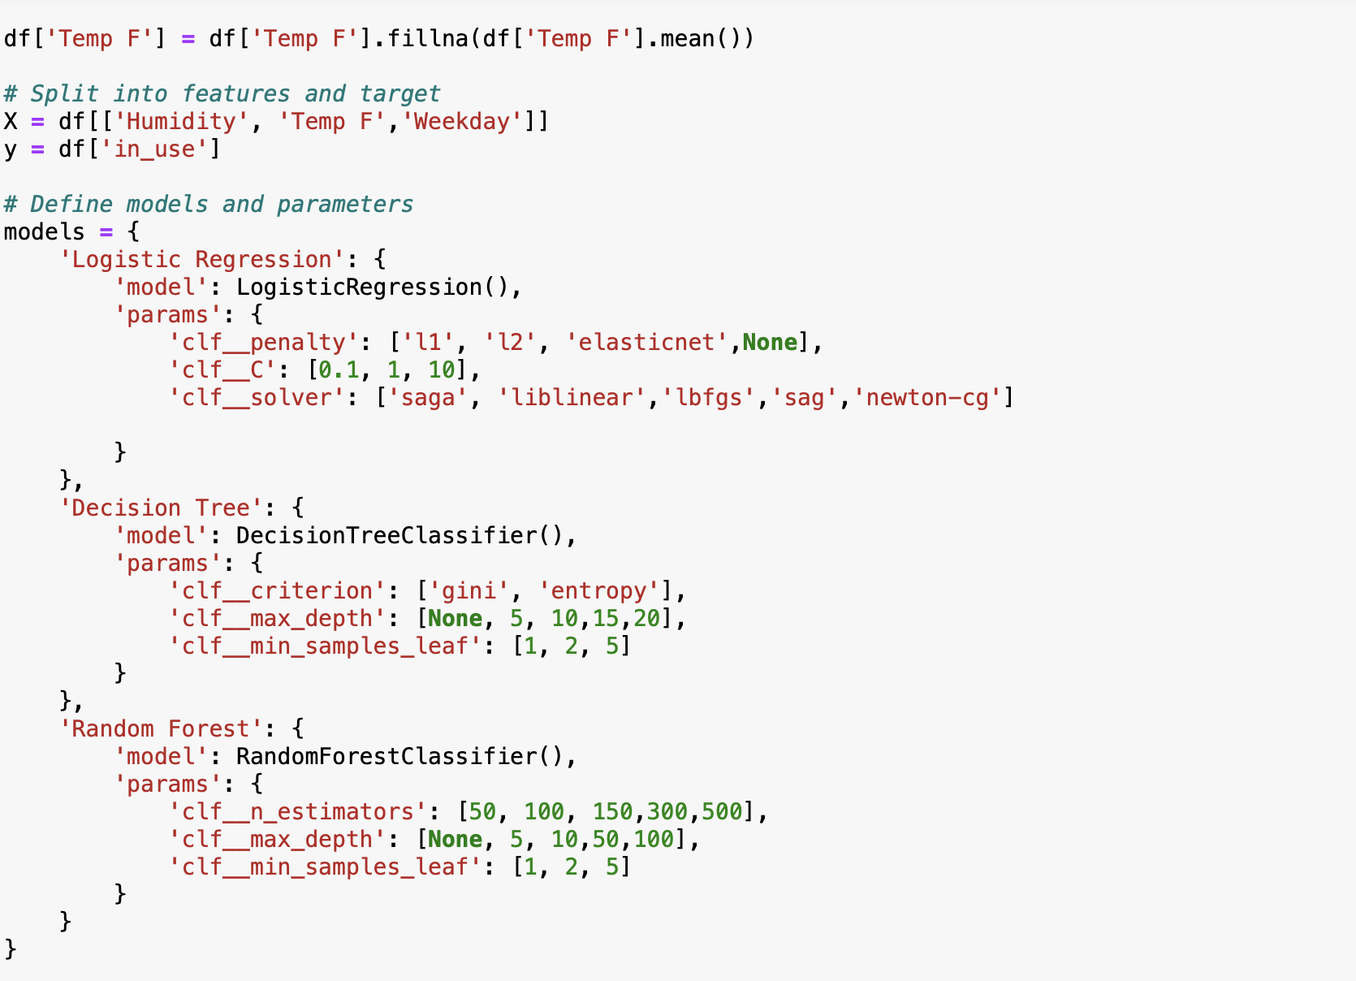
Data Collection System – Jupyter notebook

Slide 14
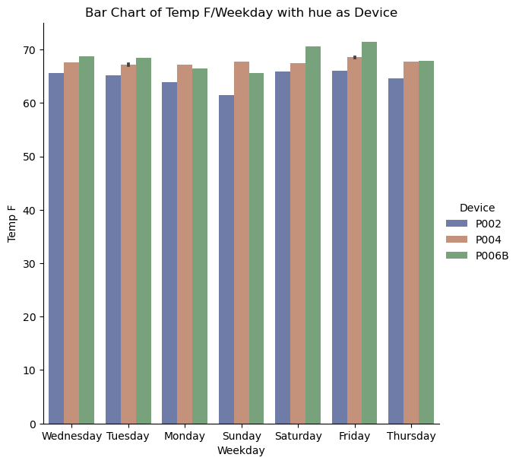
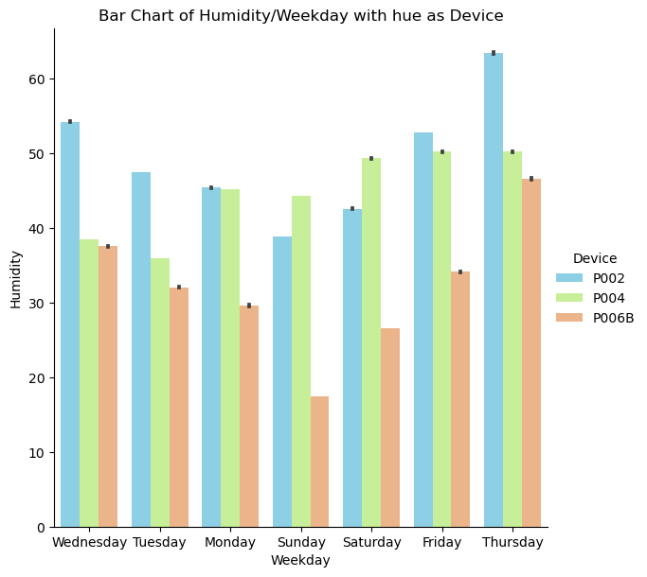
EDA – Jupyter notebook

Slide 15
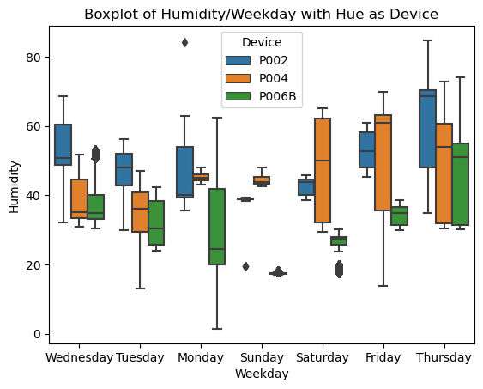
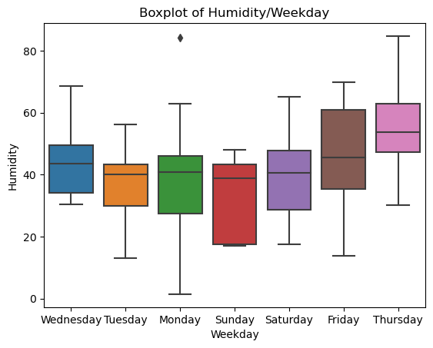
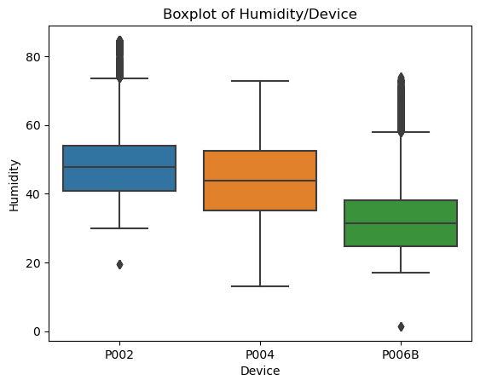
EDA – Jupyter notebook

Slide 16
EDA Summary
Notes:
I found very interesting bits of information through my EDA, such as humidity being higher on Thursdays versus the rest of the week or viewing such high correlation between Temp and Humidity, even though that was expected. I think the device that will cause me the most trouble, in terms of making predictions, will be P006B, as it is a room with no windows and having only 1 vent. Along with that, Dr. K is the only person that goes into that room, as it is his office. Even though I have a general time frame of when he is usually in his office, the times can vary greatly. Another issue I will run into will be dealing with the outliers for the Temp data. It seems most of the outliers come from P004, so I will have to make adjustments in my model to account for these outliers. In terms of making this project smoother/easier, one thing I wish I would have added to my script on the Raspberry Pi’s would be to automatically create an indicator of when classrooms are supposed to be occupied, rather than having this process being done in my analysis code. Overall, I think I am seeing great data with a high indication that I will be able to accurately predict occupancy once the model is up and running.

Slide 17
Final System
Tableau license expired
Beautifully flowing data

Slide 18
Reflection
Notes:
See Reflection part of paper

Slide 19
Summary
Great learning experience
Fun side hobby for the semester
Stressful
Resume worthy

Slide 20
Questions?

Slide 21


